Slide 1
Maryland NextGen Testbank: Comprehensive Mini-Review

Slide 2
NextGen Test Bank Disclosures
This review uses items in the Maryland NextGen Test Bank accessed with a Qualtrics link or QR Code.
The Maryland Testbank contains peer-reviewed items written by faculty across the State of Maryland that attempt to align with publicly available information about Next Generation NCLEX.
The Maryland NextGen Test Bank Project was funded by the Maryland Nursing Workforce Center as part of a grant from the Maryland Higher Education Commission Nurse Support Program II # 20-125.
This review will take approximately 2.5 to 3 hours to complete.
For best result, use a laptop, notebook, or desktop to answer the questions.

Slide 3
About The NextGen NCLEX
Starting April 1, 2023, graduates will take an updated version of the National Council Licensure Exam referred to as Next Generation NCLEX.
Next Generation NCLEX (NGN) will continue to test a candidate’s ability to provide safe client care while incorporating new methods to better test clinical judgment.
The testing methods will include using new item response types in clinical judgment case studies and stand-alone questions to test the NCSBN Clinical Judgment Measurement Model(NCJMM) (https://www.ncsbn.org/exams/next-generation-nclex/NGN+Resources/clinical-judgment-measurement-model.page)

Slide 4
The Five New Item Response Types
Extended multiple response items with increased answer options.
Drag-and-drop items that involve moving options to placeholders.
Drop-down items where candidates select the missing words from sentences, paragraphs, or tables.
Highlight items that require candidates to identify parts of the medical record to answer questions.
Matrix/grid items that involve completing tables of information.

Slide 5
Case Studies
Unfolding case studies use approved NGN item types to answer questions about evolving real-world nursing scenarios.
Case studies present 6 linked questions to test the 6 steps of the NCJMM in order:
Recognize cues
Analyze cues
Prioritize hypotheses
Generate solutions
Take action
Evaluate outcomes
Candidates should expect to complete 3 to 5 case studies in a minimum length 85 question NCLEX exam.

Slide 6
Stand-alone Item Types
Stand-alone (single) items test either client needs or clinical judgment
Client needs items test knowledge of the 8 client needs using traditional or new item types.
Clinical judgment items present information in a clinical scenario specifically targeting one or more NCJMM clinical judgment step.
There are 2 unique types of clinical judgment stand-alone items:
Bow-tie
Trend
Clinical judgment stand-alone items make up approximately 10% of stand-alone items.

Slide 7
Stand-alone Item: Bowtie
A bowtie is a drag-and-drop response item variation.
After reading a clinical scenario, candidates move response options (tokens) to placeholders (targets).
On NCLEX the placeholders are arranged in the shape of a bowtie.
Candidates must select:
1 condition the client is most likely experiencing from 4 options.
2 actions to take to address the condition from 5 options.
2 parameters to monitor the client’s progress from 5 options.

Slide 8
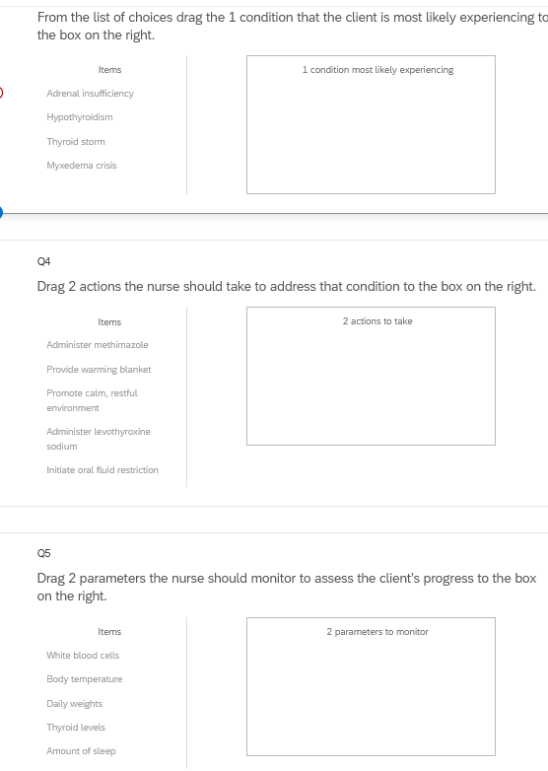
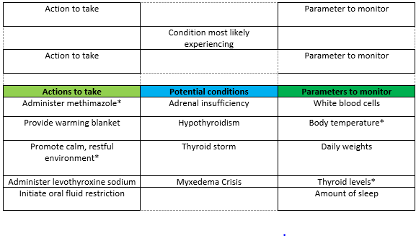
Bowties in Qualtrics
Bowties in Qualtrics are 3 drop and drag question- but they don’t make a “bowtie” shape.

Slide 9
Stand-alone Item: Trends
Trend items require the candidate to make clinical judgments based on client data presented at different time points.
Trend items may address one or more clinical judgment steps but do not follow the six-item sequence like case studies do.
Trend items can feature any item response type except bowtie.

Slide 10
About This Review
Your instructor will provide a QR code or link to answer a series of case studies, bowtie items and trends across a lifespan
While questions throughout the test bank use all 5 new item response, not all specific variations that might be used on NCLEX are not included such as drop-down items formatted as a table.
Information needed to answer questions will be displayed in a medical record, but the medical record will display differently on the actual NCLEX.
To see how items will exactly appear on NCLEX see tutorials at https://nclex.com/next-generation-nclex.page

Slide 11
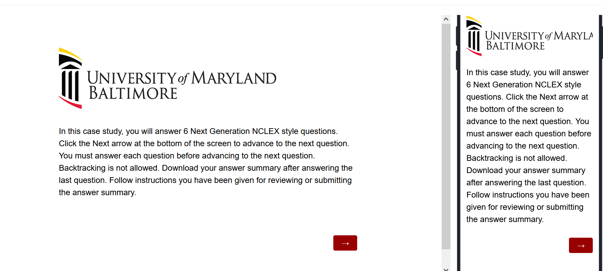
The First Screen Provides Instructions
Use the arrow to advance the screens
There is no backtracking

Slide 12
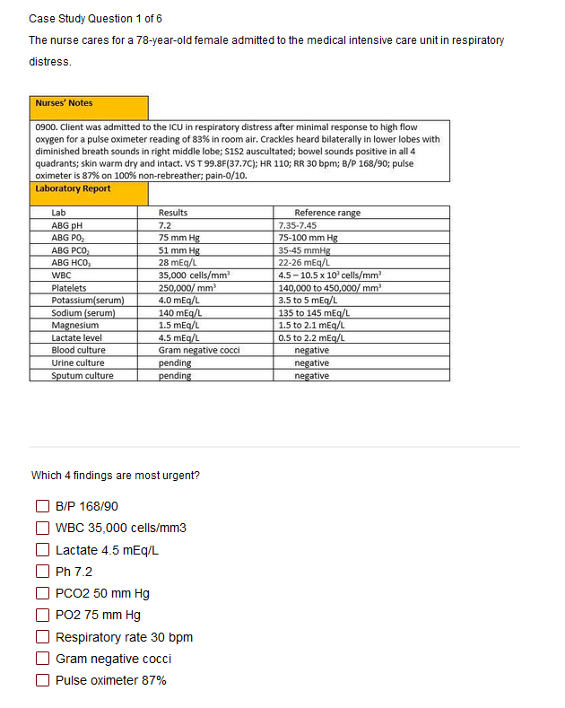

Answer the Questions
Read the instructions carefully.
Sometimes the question tells how many options to pick.
Other times you select all that apply.
Some questions will not allow you to advance if they have not answered enough options.
Use the arrow to advance to the next question if doing a case study

Slide 13
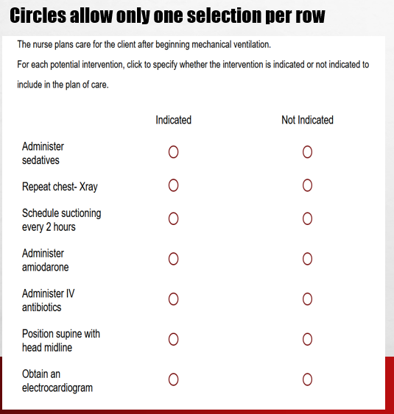
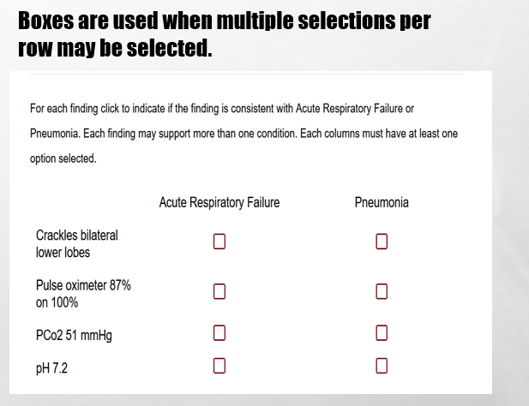
In Tables, Follow Instructions for How Many Options May be Selected in a Row.

Slide 14
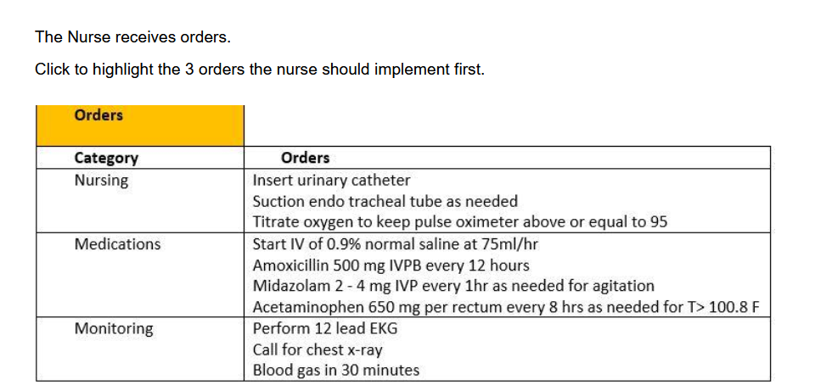
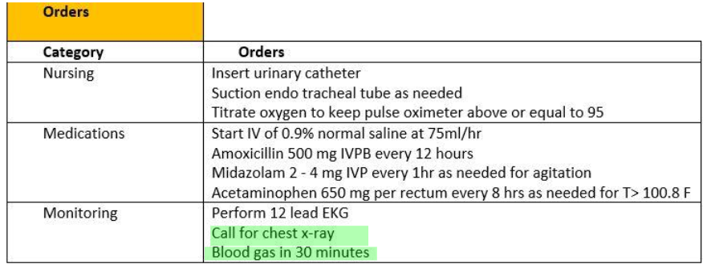
Highlight Questions
Questions first show a plain EMR page
Hovering curser makes boxes appear around selectable data
Click the box to apply the highlight; A second click removes it.

Slide 15
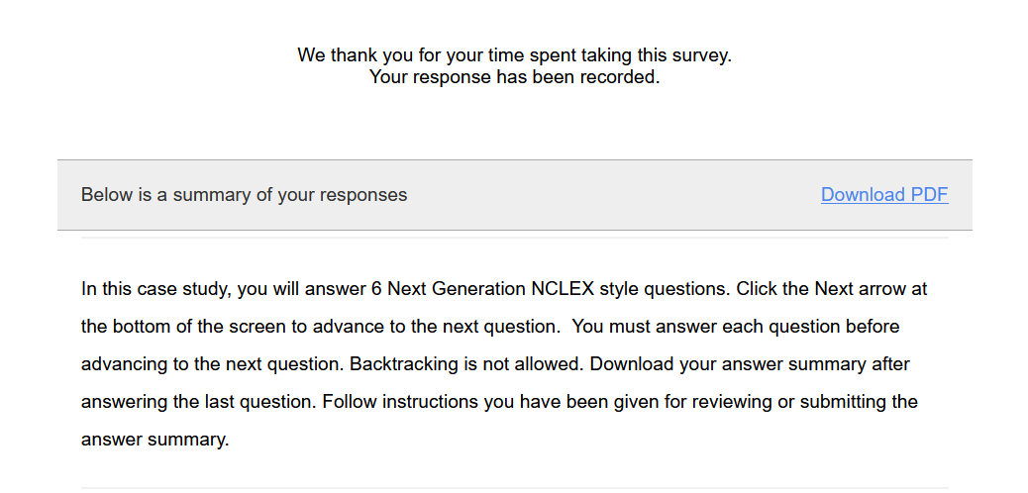
Submit the Final Question and Click Download PDF from Thank You Screen
It is the only way to save your answers.
This step is critical!

Slide 16
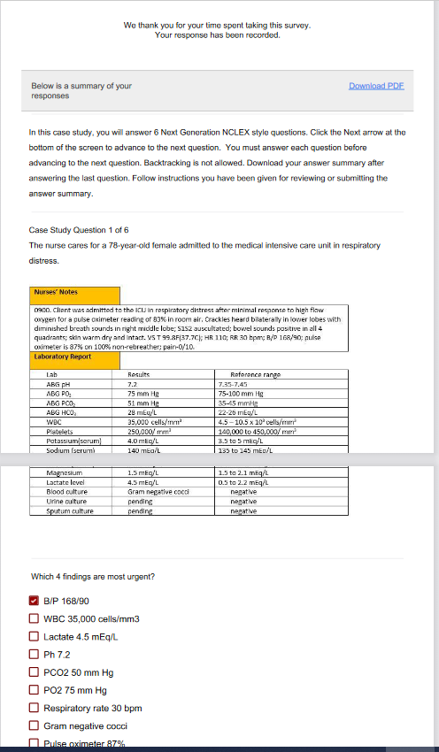
The Response Summary Shows Your Answers
Follow your faculty’s instructions for saving the response summary.
They may have you print it out, save it to computer, or upload it to a learning management system.
The response summary DOES NOT give you the correct answers.
Answers will appear on subsequent slides with information on how to score the item and a rationale for the answer.

Slide 17
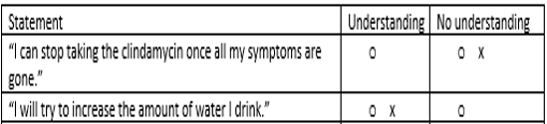
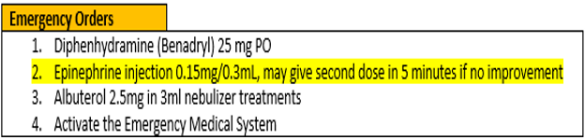
Correct Answers
Correct answers may be indicated 1 of 4 ways
Asterisk appears after correct option*
Option may be underlined with or without an *
Option may appear as an X or * in a table
Correct answer may appear as highlight

Slide 18
New Scoring Rule: +/-
Used when takers may pick unlimited options
Possible points are number of keyed correct items
Earn 1 point for each correct item selected
Loose 1 point for each incorrect item selected
Guessing penalty prevents takers from gaming system by selecting all
Minimum score =0
Which items are viruses? Select all that apply.
■ Chlamydia
■ Influenza[✓]
■ Hepatitis B [✓]
Lyme disease
Pertussis
Tuberculosis
Varicella [✓]
+/- Scoring rule
3 points possible
+2 correct
-1 incorrect
-----------------
1 points

Slide 19
New Scoring Rule: 0/1
Used when takers may select limited options
Possible points are number of keyed correct items
Earn 1 point for each correct item selected
Earn 0 points for incorrect responses
Minimum score 0
Which 3 items are viruses?
■ Chlamydia
■ Influenza[✓]
■ Hepatitis B [✓]
Lyme disease
Pertussis
Tuberculosis
Varicella [✓]
0/1 Scoring rule
3 points possible
+2 correct
-----------------
2 points

Slide 20
Same Answers: Different Scores
Select all that apply
Which 3 items are viruses?
■ Chlamydia
■ Influenza[✓]
■ Hepatitis B [✓]
Lyme disease
Pertussis
Tuberculosis
Varicella [✓]
Which items are viruses? Select all that apply
■ Chlamydia
■ Influenza[✓]
■ Hepatitis B [✓]
Lyme disease
Pertussis
Tuberculosis
Varicella [✓]
0/1 Scoring rule
3 points possible
+2 correct
-----------------
2 points
+/- Scoring rule
3 points possible
+2 correct
-1 incorrect
-----------------
1 point

Slide 21
Rationale Scoring Rule
Complete the sentence from list of dropdown options.
To prevent night blindness the nurse would recommend
because they are rich in vitamin
Used when question has linked concept and a justification in the same sentence
Example: The client most likely has an asthma exacerbation as evidenced by the breath sounds.
Dyad worth 1 point
One cause and one effect
Both parts must be correct for credit
Triad worth 2 points
One cause 2 effects
Cause must be right for any credit
Partial credit given (1 point) if only 1 effect is correct
almonds
carrots✓
orange juice
A
B
C✗
Right condition,
Wrong justification =0 points

Slide 22
Keep track of your score as you move through the review
Case Study | My score | Standalone | My score
Case study 1 |  | Bowtie 1
Case study 2 |  | Trend 1
Case study 3 |  | Bowtie 2
Case study 4 |  | Trend 2
Case study 5 |  | Bowtie 3
 |  | Trend 3
Case Study Total |  | Stand alone Total

Slide 23
Final Link
The final link in the review takes you to the course evaluation.
This anonymous information will be used to help us understand how this review is being used and how to improve the experience.

Slide 24
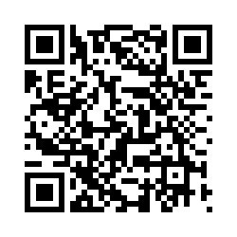
Case Study # 1
URL
QR Code
https://umaryland.az1.qualtrics.com/jfe/form/SV_8cQvohVkmgfi6Wy
Take about 10 minutes

Slide 25
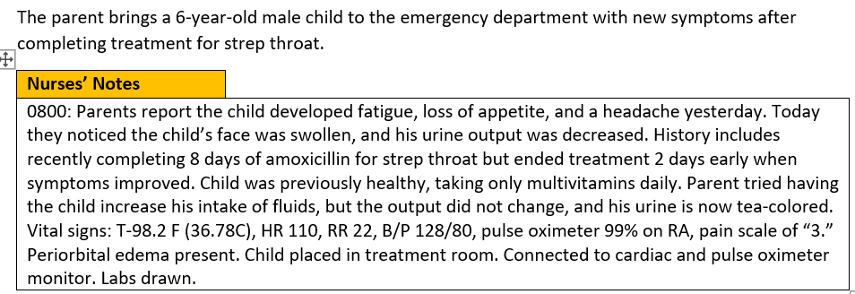
Screen 1 of 6
Drag the 4 findings are most significant to the box on the right
Client Findings
Blood pressure*
Periorbital edema*
Poor appetite
Headache
Fatigue
Urine output*
Increased intake of fluids
History of strep throat*
0/1. This question is worth 4 points.
Give yourself 1 point for each correct response.

Slide 26
Rationale
The blood pressure for an 8- year-old should be less than 120/80. The history of recent strep throat, blood pressure, periorbital edema and changes in urine output are the most significant findings because they suggest the child has poststreptococcal glomerulonephritis. The child is at risk for heart failure, seizures, and encephalopathy due to hypertension and fluid overload as evidenced by bilateral periorbital edema, decreased urine output, hematuria, and high blood pressure of 128/80.

Slide 27
Screen 2 of 6
The nurse suspects poststreptococcal glomerulonephritis and considers the child’s risks.
Which of the following complications is the client at risk for experiencing? Select all that apply
Bowel obstruction
Heart failure*
Diabetes
Liver failure
Fluid overload*
Acute renal failure*
Adrenal insufficiency
Hypertension*
+/-. This question is worth 4 points.
Give yourself 1 point for each correct response
AND subtract 1 point for each incorrect response you selected. The least you can score is 0.

Slide 28
Rationale
The child is at risk for fluid overload leading to hypertension and cardio- pulmonary congestion leading to heart failure. Untreated the decreased urine output, hematuria, and high blood pressure can lead to renal failure. Gastrointestinal, endocrine, and hepatic complications are not known ramifications of poststreptococcal glomerulonephritis.

Slide 29
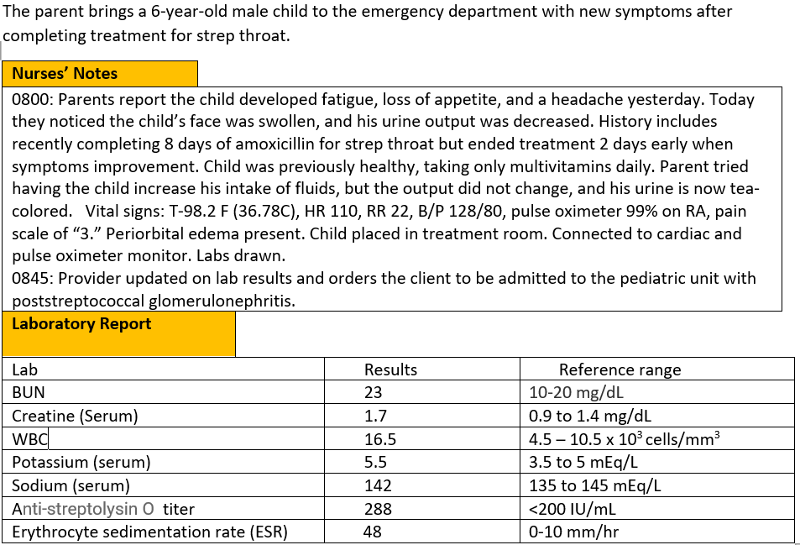
Screen 3 of 6
Labs return and the child receives the diagnosis of poststreptococcal glomerulonephritis.
Complete the sentence from the list of drop-down options.
The problem the nurse needs to address first is | treating the infection lowering the blood pressure managing the fluid overload*
0/1. This question is worth 1 point.
Give yourself 1 point if you answered correctly.

Slide 30
Rationale
The top priority is to manage the fluid overload. Managing the overload will help the blood pressure. The nurse will anticipate orders to treat the infection, however the problem is being caused by an immune response not an infection.

Slide 31
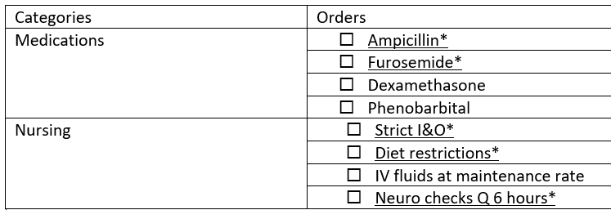
Screen 4 of 6
Select the orders from each of the categories the nurse should anticipate including in the plan of care. Each category may have more than one order.
+/-. This item is worth 5 points- Score each category separately and then add the category scores together.
Score 1 point for each correct answer AND subtract 1point for each incorrect answer. The worst you can score is 0 per category
Medications=2 points
Nursing= 3 points.

Slide 32
Rationale
The top priority is to manage the fluid overload. Managing the overload will help the blood pressure. The nurse will anticipate orders to treat the infection, however the problem is being caused by an immune response not an infection.

Slide 33
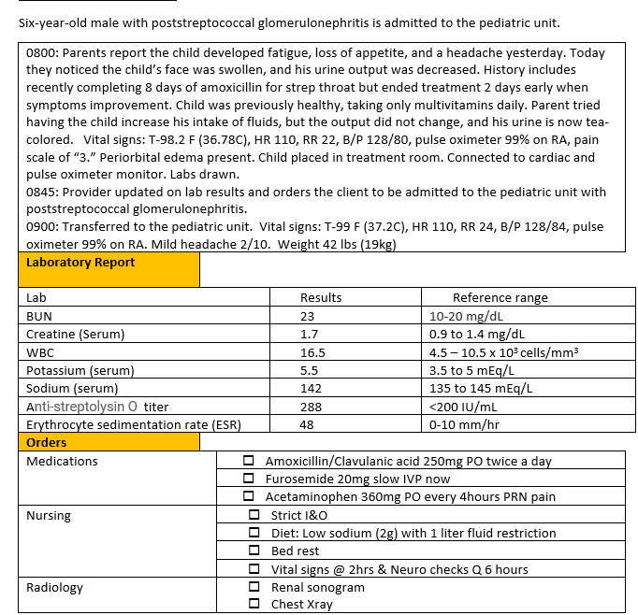
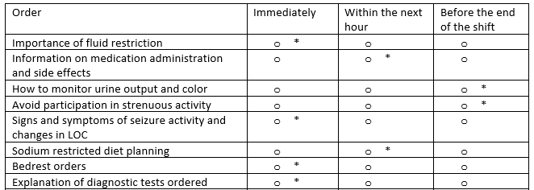
Screen 5 of 6
The The nurse plans the family teaching about the treatment plan.
For each teaching point, click to specify if the nurse should address the teaching immediately upon admission, within the next hour, or before the end of the shift.
0/1. This item is worth 8 points. Give yourself 1 point for every row you got right.

Slide 34
Rationale
When teaching is complex, teaching should be broken down into short segments. Upon admission the things that are most important for the nurse to address before leaving the client alone are the bedrest and fluid restriction orders, signs and symptoms to call the nurse for (in this case seizures or changes in LOC) and diagnostic test that are ordered so the client will not be surprised if another team member comes into the room. Medication teaching should be done when the medicine is given. Diet teaching will need to be done before lunch. Since the client is on bedrest discussions of strenuous activities can occur later. Discussions of monitoring urine output can occur when the child needs to void.

Slide 35
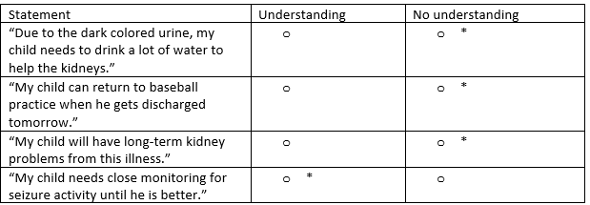
Screen 6 of 6
The nurse evaluates the family’s understanding of the treatment plan.
For each client statement, click to specify whether the statement indicates an understanding, or no understanding of teaching provided.
0/1. This item is worth 4 points. Give yourself 1 point for every row you got right.

Slide 36
Rationale
The child is experiencing poststreptococcal glomerulonephritis. The child is at risk for seizures and encephalopathy. The parent must understand the importance of close monitoring for changes in LOC or seizure activity and when to seek additional medical attention.

Slide 37
Case Study 1 Score
Question | Possible | My score
1 | 4
2 | 4
3 | 1
4 | 5
5 | 8
6 | 4
Total | 26

Slide 38
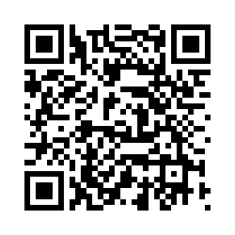
Bowtie # 1
URL
QR Code
https://umaryland.az1.qualtrics.com/jfe/form/SV_3e2Dw5IGoxrIW4m
Take 2-3 minutes

Slide 39
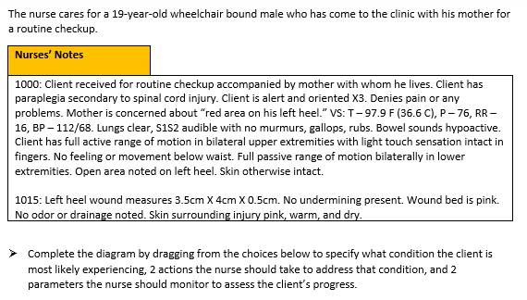
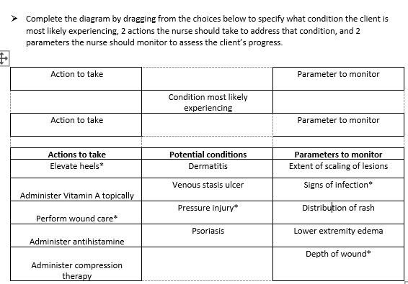
0/1. This item is worth 5 points. Give yourself 1 point for every correct selection.

Slide 40
Rationale
The assessment data (location over bony prominence, shallow wound, surrounding skin within normal parameters) indicates a stage II pressure injury. Wound care will facilitate healing and elevating the heels while in bed will relieve direct pressure. The wound should be monitored for signs of infection. A decrease in wound depth would indicate that the pressure injury was improving.

Slide 41
Case Bowtie 1 Score
Question | Possible | My score
Conditions | 1
Actions | 2
Parameters | 2
Total | 5

Slide 42
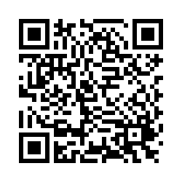
Case Study # 2
URL
QR Code
https://umaryland.az1.qualtrics.com/jfe/form/SV_3eKszlC4xNo4CJE
Take about 10 minutes

Slide 43
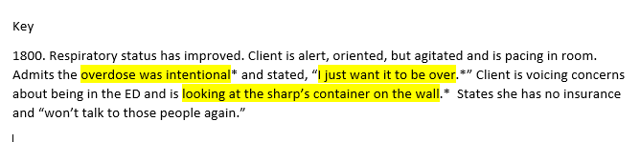
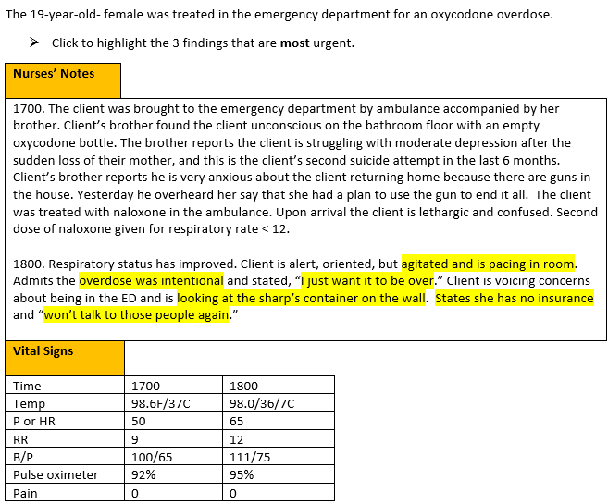
Screen 1 of 6
+/-. This question is worth 3 points.
Give yourself 1 point for each correct response AND subtract 1 point for every incorrect answer you picked. The worst you can score is 0.
6 statements are selectable

Slide 44
Rationale
The priority concern for this client is safety. The RN should immediately follow up with the brother’s statement about guns being in the house and the client having an active plan to use them to cause harm. The RN should also be concerned about access to the sharps box with her recent suicide attempt and the client’s statement of wanting to end her life.

Slide 45
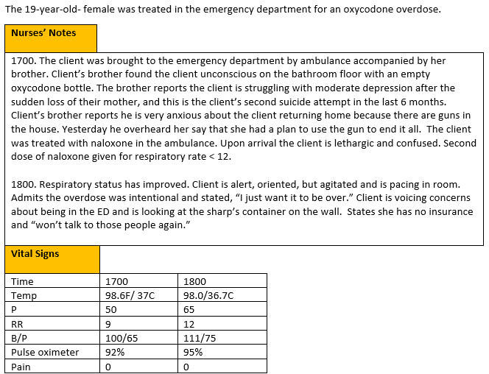
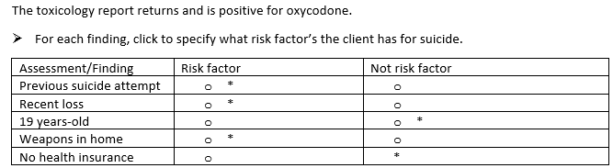
Screen 2 of 6
0/1. This question is worth 5 points.
Give yourself 1 point for each row you got correct.

Slide 46
Rationale
Per the CDC, risk factors for suicide include previous suicide attempts, mental illness such as depression, substance use disorder, relationship problems such as a loss, etc.

Slide 47
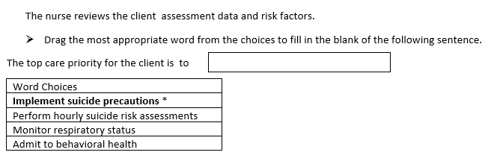
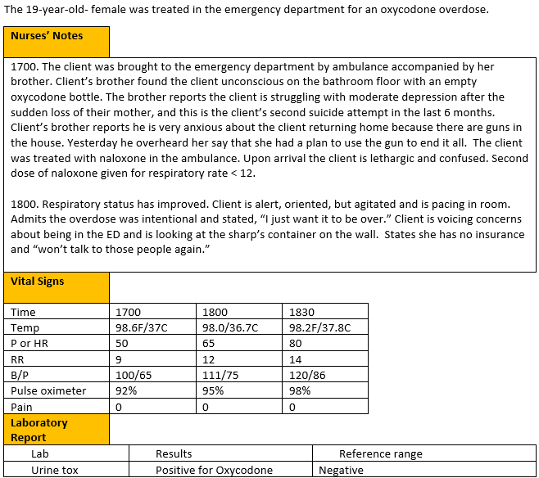
Screen 3 of 6
0/1. This question is worth 1 point.
Give yourself 1 point if you answered correctly.

Slide 48
Rationale
The client is presenting with several safety concerns, and it is crucial to keep them safe. While it is important to continue suicide risk assessments, it is clear the client is presenting with immediate safety needs related to suicidal comments and behaviors and suicide precautions must be implemented. Hourly suicided assessments are not sufficient.

Slide 49
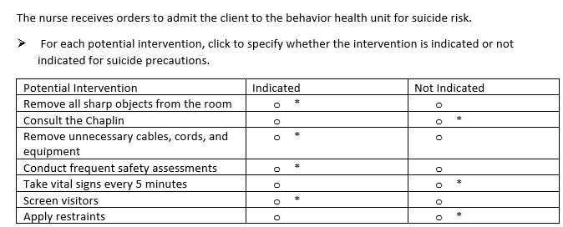
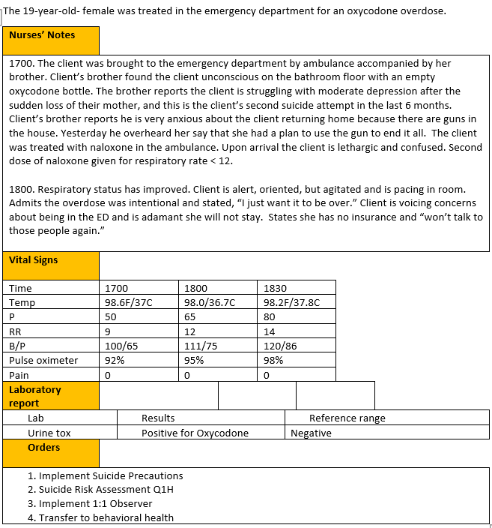
Screen 4 of 6
0/1. This item is worth 7 points. Give yourself 1 point for every row you got right.

Slide 50
Rationale
The room should be prepared with limited linen, removal of all sharp objects, and removal of unnecessary cables, cords, and equipment when a client is on suicide precautions. There is not necessarily a restriction on staff or visitors. Visitors should be screened, and a Chaplin can be consulted per the client request. It is important to conduct frequent safety assessments, but vital signs every 5 minutes and restraints are not necessary currently.

Slide 51
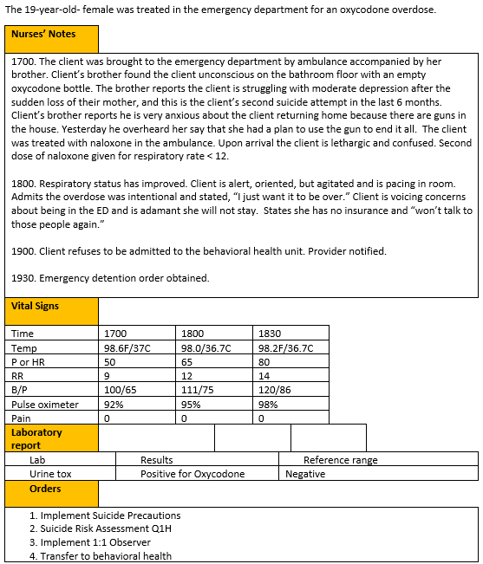
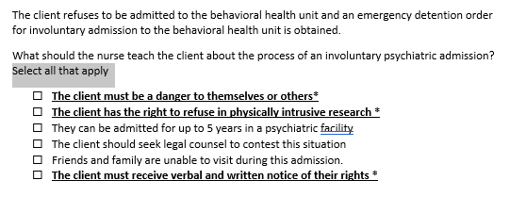
Screen 5 of 6
The
+/-. This item is worth 3 points. Give yourself 1 point for every correct option you selected AND subtract 1 point for every incorrect item you selected. The worst you can score is 0.

Slide 52
Rationale
An involuntary psychiatric admission is granted when a client is a danger to themselves or others and if a client is unwilling to be admitted. The client must be given verbal and written information within 12 hours stating the reason for the involuntary admission, availability of legal services and their right to talk to a lawyer. Clients retain the right to be cared for in the least restrictive environment and the right to refuse to participate in any form of human subject’s research.

Slide 53
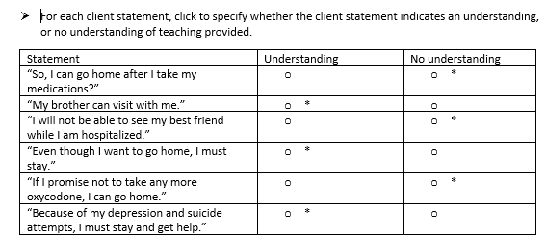
Screen 6 of 6
The
0/1. This item is worth 6 points. Give yourself 1 point for every row you got right.

Slide 54
Rationale
The client verbalizes understanding when she states her brother can visit with her, friends and family are not limited to visitation. The client verbalizes understanding that even though she wants to be discharged, legally she will be admitted against her wishes due to her history of depression and suicide attempts.

Slide 55
Case Study 2 Score
Question | Possible | My score
1 | 3
2 | 5
3 | 1
4 | 7
5 | 3
6 | 6
Total | 25

Slide 56
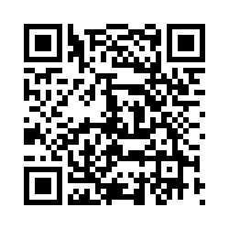
Trend # 1
URL
QR Code
https://umaryland.az1.qualtrics.com/jfe/form/SV_02IHwhHpiblxzb8
Take 2-3 minutes

Slide 57
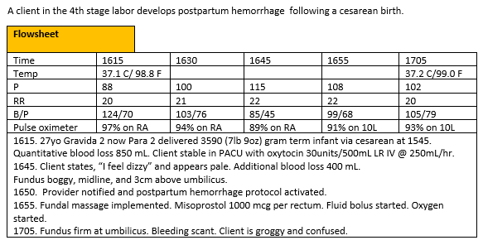
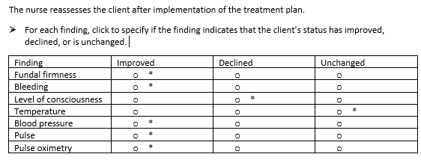
0/1. This item is worth 7 points. Give yourself 1 point for every row you got correct .

Slide 58
Rationale
The trends in the vital signs, firm fundus, and cessation of bleeding indicate the client is improving. The level of consciousness has declined from dizzy to groggy due to the blood loss. The correct action is to continue to monitor the patient.

Slide 59
Trend 1 Score
 | Possible | My score
Points | 7
Total | 7

Slide 60
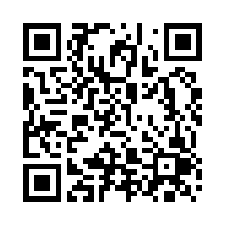
Case Study 3
URL
QR Code
https://umaryland.az1.qualtrics.com/jfe/form/SV_1RAIcNZ0SmsBAlE
Take about 10 minutes

Slide 61
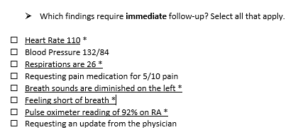
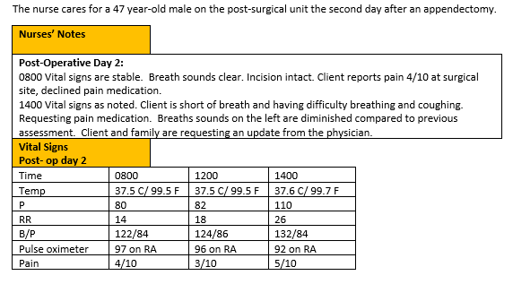
Screen 1 of 6
+/-. This question is worth 5 points.
Give yourself 1 point for each correct response AND subtract 1 point for every incorrect answer you picked. The worst you can score is 0.

Slide 62
Rationale
The nurse should identify signs and symptoms of post-operative complications that need to be addressed. Signs of atelectasis include increased heart rate, increased respirations, breathing difficulties and low oxygen levels. Breath sounds will be diminished due to collapsed alveoli. Blood pressure is not affected unless it becomes elevated due to the stress of breathing difficulties. Pain medication is important but first the breathing issues must be addressed.

Slide 63
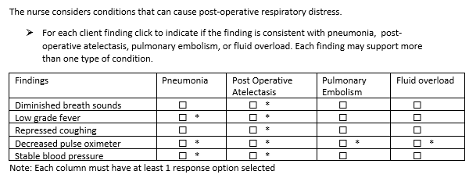
Screen 2 of 6
+/-. This question is worth 10 points. Score each column separately first, then add scores together. Earn 1 point for each correct item selected AND subtract 1 point for each incorrect option you select. The worst you can score is 0 per column.
Column 1- 3 points
Column 2 -5 points
Column 3 -1 points
Column 4 -1points

Slide 64
Rationale
The nurse should differentiate signs and symptoms of atelectasis, pneumonia, pulmonary embolism, and fluid overload in clients with respiratory distress following surgery. All respiratory issues include shortness of breath and increased respirations, and decreased pulse oximeter readings. Diminished breath sounds and repressed coughing are most associated with post-op atelectasis. Coughing, rhonchi, wheezing, or crackles would be expected with the other three conditions. Low-grade fever and normal and stable blood pressures would be expected with atelectasis and pneumonia. Fever could also be higher with pneumonia. Unstable blood pressures would be expected for pulmonary embolism or fluid overload. Hypotension is typically seen with pulmonary embolism. Hypertension is associated with fluid overload.

Slide 65
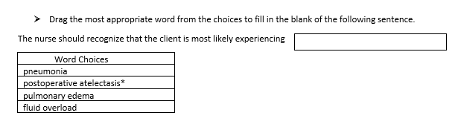
Screen 3 of 6
0/1. This question is worth 1 point.
Give yourself 1 point if you answered correctly.

Slide 66
Rationale
The client’s respiratory findings along with the diminished breath sounds, repressed cough, low grade fever and stable blood pressure most suggest the client is experiencing atelectasis.

Slide 67
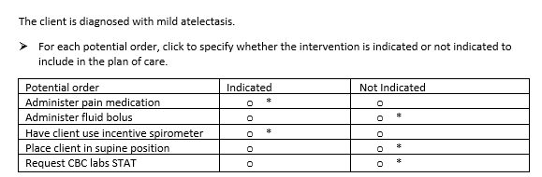
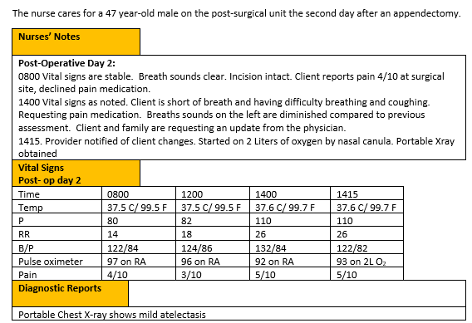
Screen 4 of 6
0/1. This item is worth 5 points. Give yourself 1 point for every row you got right.

Slide 68
Rationale
The XRAY confirms atelectasis. Proper nursing interventions include sitting the client up to aid with breathing. Supine position can make breathing more difficult. Applying oxygen via nasal cannula can also make breathing easier. Using the incentive spirometer can also make breathing easier. Controlling pain improves compliance with incentive spirometry. Extra fluid does not help a client with breathing and can put the client at risk for fluid overload. A CBC is not necessary for monitoring atelectasis as it would be for detecting and infection.

Slide 69
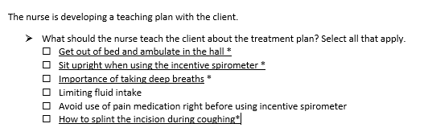
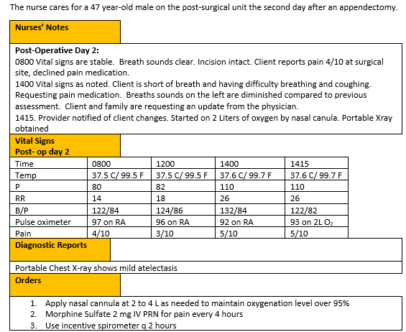
Screen 5 of 6
The
+/-. This item is worth 4 points. Give yourself 1 point for every row you got right AND subtract 1 point for every incorrect item you selected. The worst you can score is 0.

Slide 70
Rationale
The nurse should teach the client with atelectasis interventions that can improve their oxygenation. The nurse can instruct the client to be out of bed and ambulate, to take deep breaths in order to increase lung capacity and open up the alveoli. The incentive spirometer can also help improve lung function. The client should increase the fluids to about 3,000 ml /day to thin mucous secretions and use pain medication so they can take deep breaths.

Slide 71
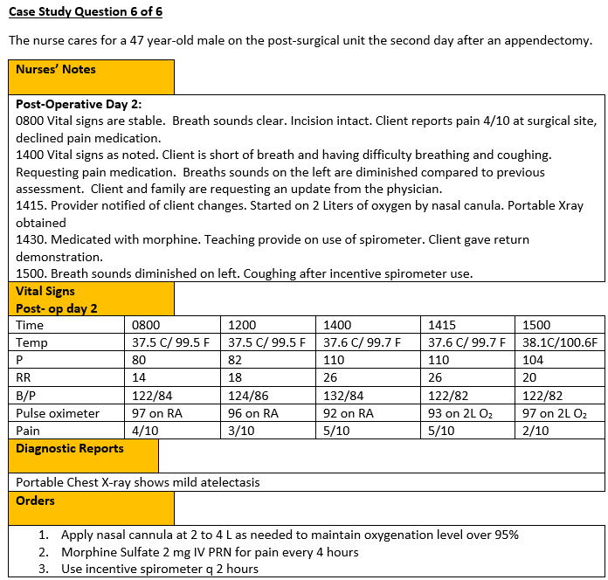
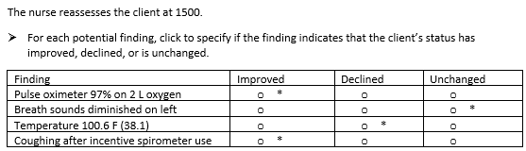
Screen 6 of 6
The
0/1. This item is worth 4 points. Give yourself 1 point for every row you got right.

Slide 72
Rationale
The nurse should recognize that the client has improved if the oxygen saturation is within normal limits and the client is coughing after using the incentive spirometer. Breath sounds were diminished on left and make take several cycles of deep breathing and coughing to improve. The increasing fever would indicate that the client’s condition had decreased and an infection may now be present.

Slide 73
Case Study 3 Score
Question | Possible | My score
1 | 5
2 | 10
3 | 1
4 | 5
5 | 4
6 | 4
Total | 29

Slide 74
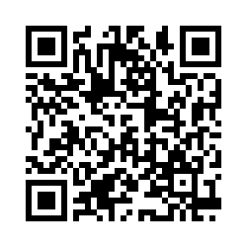
Bowtie # 2
URL
QR Code
https://umaryland.az1.qualtrics.com/jfe/form/SV_2nkk8caqQOO0gx8
Take 2-3 minutes

Slide 75
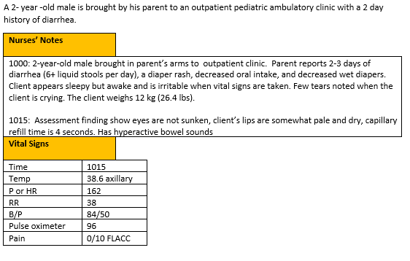

0/1. This item is worth 5 points. Give yourself 1 point for every correct selection.

Slide 76
Rationale
The child is showing signs of moderate dehydration including decreased tears, decreased urine output, pale/dry oral mucosa and irritability. He is not demonstrating hypotension or signs of shock at this time. It is the standard of care to attempt oral rehydration in an outpatient setting for moderate dehydration, but the child’s perfusion and circulation should be monitored to ensure he does not decompensate. His intake should also be closely monitored to ensure he is retaining some of the rehydration offered.

Slide 77
Bowtie 2 Score
Question | Possible | My score
Conditions | 1
Actions | 2
Parameters | 2
Total | 5

Slide 78

Case Study # 4
URL
QR Code
https://umaryland.az1.qualtrics.com/jfe/form/SV_eX9s0hwdlD6QpBI
Take about 10 minutes

Slide 79


Screen 1 of 6
+/-. This question is worth 5 points.
Give yourself 1 point for each correct response AND subtract 1 point for every incorrect answer you picked. The worst you can score is 0.

Slide 80
Rationale
Primary signs of compartment syndrome include the “5 P’s,” Pain (out of proportion/not relieved with pain medication), Pallor, Pulses (diminished or absent), Paresthesia, Paralysis. Additionally, fullness, cool or cold extremity, and weakness may occur. Any of these symptoms are indicative of neurovascular compromise. If untreated could result in tissue death and loss of limb. The pedal pulse will not be able to be assessed due to the cast.

Slide 81

Screen 2 of 6
0/1. This question is worth 6 points. Give yourself a point for each row you got right.

Slide 82
Rationale
The nurse should differentiate between acute complications of a fracture and chronic or late complications. Acute complications include deep vein thrombosis or pulmonary embolism, fat embolism, and compartment syndrome. Late, or chronic complications include complex regional pain syndrome, avascular necrosis, osteomyelitis, and delayed union.

Slide 83

Screen 3 of 6
Rationale. This question is worth 1 point.
Give yourself 1 point only if you answered BOTH parts correctly.

Slide 84
Rationale
Compartment syndrome is suspected based on the abnormal findings in the neurovascular assessment. While some of the vital signs are abnormal, and the client is tachycardic there can be causes other than compartment syndrome for these findings.

Slide 85


Screen 4 of 6
+/-.This question is worth 6 points. Score each group separately first then add scores together. Earn 1 point for each correct item selected AND subtract 1 point for each incorrect option you select. The worst you can score is 0 per group.
Nursing- 3 points
Medications – 2 point
Collaborative- 1 point

Slide 86
Rationale
The nurse should prioritize interventions that would relieve pressure within the compartment, monitor for improving or declining condition, and treat potential life or limb threatening conditions. This would include frequent neurovascular assessments and preparing to remove the cast as soon as possible by getting the cast removal saw to the bedside. The provider is likely to insert a compartment pressure measurement manometer to assess compartmental pressures. Client should be kept NPO in the event surgery is required. Pain medication such as morphine is indicated, and due to hypotension an IV fluid bolus is indicated. Ibuprofen is not effective for the pain rate of 10/10, and 400 mg would not be a therapeutic dose. Aspirin is contraindicated due to the anticoagulation component if the client needs surgery. The surgical team should be consulted. Client would not be instructed on crutch walking at this time until the compartment syndrome is resolved. Respiratory and Case Management for long-term care are not indicated at this time.

Slide 87


Screen 5 of 6
The
+/-. This item is worth 5 points. Give yourself 1 point for every correct option you selected AND subtract 1 point for every incorrect item you selected. The worst you can score is 0.

Slide 88
Rationale
To accomplish all the tasks needed to care for this client the nurse may delegate some tasks to the UAP. The UAP is unable to perform assessments or monitor neurovascular status. t is the nurses’ responsibility to ensure client is ready for surgery. The pre-operative checklist may be used to ensure all pre-operative criteria is met. Measuring and documenting VS, Intake and Output, height and weight may all be done by the UAP. The UAP may also help the client to maintain the extremity in the proper position as instructed by the Nurse.

Slide 89


Screen 6 of 6
The
0/1. This item is worth 7 points. Give yourself 1 point for every row you got right.

Slide 90
Rationale
The nurse determines the client’s Pain rate, motion and color are improving since the onset of symptoms (1100) as evidenced by the data in the neurovascular assessment. The pulse and temperature declined, and the sensation and capillary refill remained unchanged.

Slide 91
Case Study 4 Score
Question | Possible | My score
1 | 5
2 | 6
3 | 1
4 | 6
5 | 5
6 | 7
Total | 30

Slide 92

Trend # 2
URL
QR Code
https://umaryland.az1.qualtrics.com/jfe/form/SV_0DSrwqlb366JHx4
Take 2-3 minutes

Slide 93


0/1. This item is worth 8 points. Give yourself 1 point for every row you got right.

Slide 94
Rationale
Elevated blood pressure and missed doses of medication are cause for further assessment and patient education. Abdominal pain could be a sign of a medication side effect off liver involvement Pulse oximeter has increased on room air, temperature is normal, and WBC count is within normal limits. Productive cough and fatigue are unchanged from initial visit.

Slide 95
Trend 2 Score
Question | Possible | My score
Points | 8
Total | 8

Slide 96

Case Study # 5
URL
QR Code
https://umaryland.az1.qualtrics.com/jfe/form/SV_eyabT2E95Uker4O
Take about 10 minutes

Slide 97


Screen 1 of 6
+/-/ This question is worth 4 points.
Give yourself 1 point for each correct response AND subtract 1 point for every incorrect answer you picked. The worst you can score is 0.

Slide 98
Rationale
Magnesium toxicity is characterized by respiratory depression, decreased urinary output, and loss of deep tendon reflexes. Cutaneous flushing and sweating are expected side effects of magnesium administration and are not concerning. Blood pressure at 0900 is expected since the client has severe preeclampsia. Magnesium infusion can cause hypotension.

Slide 99


Screen 2 of 6
+/-. This question is worth 3 points
Give yourself 1 point for each correct response AND subtract 1 point for every incorrect answer you picked. The worst you can score is 0.

Slide 100
Rationale
Any time the client is experiencing a complication the fetus should be assessed. Patients with preeclampsia and magnesium toxicity can experience pulmonary edema and changes in LOC, which would provide the nurse with additional assessment data.

Slide 101

Screen 3 of 6
0/1. This question is worth 1 point.
Give yourself 1 point if you answered correctly.

Slide 102
Rationale
Trends are consistent with magnesium toxicity. Abruption would be accompanied by abdominal pain, uterine tenderness, potentially vaginal bleeding, and fetal distress. Seizures are required for eclampsia. Pulmonary embolism would be accompanied by chest pain.

Slide 103

Screen 4 of 6
0/1. This question is worth 10 points. Give yourself 1 point for each row you got correct.

Slide 104
Rationale
When magnesium toxicity is suspected the infusion should be stopped, a rapid response activated, and calcium gluconate administered. The patient should receive oxygen because of respiratory depression. The fetus should be assessed any time there is a complication with the mother. Serum magnesium would confirm toxicity. Checking for medication error is necessary after medication-related complications. Supine position could make shortness of breath worse. Anti-seizure medication would be necessary for eclampsia, which this client does not have. Elevation of extremities is unrelated to magnesium toxicity.

Slide 105

Screen 5 of 6
The
0/1. This item is worth 3 points. Give yourself 1 point for every correct option selected.

Slide 106
Rationale
Priority actions are to get help, stop the infusion, and administer the antidote calcium gluconate. The other interventions are warranted but not the immediate priority.

Slide 107


Screen 6 of 6
The
0/1. This item is worth 2 points. Give yourself 1 point for each correct response.

Slide 108
Rationale
Calcium gluconate is the antidote for magnesium toxicity and can be administered more than once if there is no improvement in client condition. Client has not improved, and magnesium sulfate infusion would be contraindicated. ICU is not warranted at this time.

Slide 109
Case Study 5 Score
Question | Possible | My score
1 | 4
2 | 3
3 | 1
4 | 10
5 | 3
6 | 2
Total | 23

Slide 110

Bowtie # 3
URL
QR Code
https://umaryland.az1.qualtrics.com/jfe/form/SV_eljHHkEaqnMqXH0
Take 2-3 minutes

Slide 111


0/1. This item is worth 5 points. Give yourself 1 point for every correct selection.

Slide 112
Rationale
Rationale: Student has symptoms that relate to hypoglycemia, it would be important to check the student’s history and obtain a blood glucose at this time. Student pulse is elevated and should continue to be monitored and the student is currently speaking and oriented this would need to continue to be monitored to make sure no changes in orientation occur.

Slide 113
Bowtie 3 Score
Question | Possible | My score
Conditions | 1
Actions | 2
Parameters | 2
Total | 5

Slide 114

Trend # 3
URL
QR Code
https://umaryland.az1.qualtrics.com/jfe/form/SV_54rWUN5iC91OzYO
Take 2-3 minutes

Slide 115


0/1. This item is worth 1 point. Give yourself 1 point if you got it correct.

Slide 116
Rationale
Side effects are predictable unintended responses to medications. For stimulants used to treat attention deficit hyperactivity disorders side effects include decreased appetite, rapid weight loss and insomnia. Side effects can often be managed without discontinuing treatment. Adverse reactions are less predictable, more severe, and more likely to require discontinuing treatment. The client is having a therapeutic effect (improved behavior/school performance) on the target dose thus it is unlikely the effects are due to non- compliance. There is no evidence of drug dependence.

Slide 117
Trend 3 Score
Question | Possible | My score
Points | 1

Slide 118
My Total
Case study | Possible Points | My score | Standalone | Possible Points | My score
Case study 1 | 26 |  | Bowtie 1 | 5
Case study 2 | 25 |  | Trend 1 | 7
Case study 3 | 29 |  | Bowtie 2 | 5
Case study 4 | 30 |  | Trend 2 | 8
Case study 5 | 23 |  | Bowtie 3 | 5
 |  |  | Trend 3 | 1
Case Study Total | 133 |  | Stand alone Total | 31
Total Possible | 164 |  | My score

Slide 119

Please Complete the Mini Review Evaluation
https://umaryland.az1.qualtrics.com/jfe/form/SV_1ZYu3gxvlMDziMS
This evaluation will take approximately less than 2 minutes to complete.

